Slide 1
Problem Solving
Nov 7, 2018

Slide 2
Lecture overview
Types of problems
Theories
  Representational Change Theory
  Progress Monitoring Theory
Transfer of Training

Slide 3
Some problems
It is the evening before an exam, the text book you need is unavailable in the library and the bookshop is closed.
You have upgraded your computer from Windows 2000 to Windows Vista and want to perform certain operations as before
You wish to avoid stale-mate in chess
You wish to become a better football player

Slide 4
Factors to be considered
It is the evening before an exam, the text book you need is unavailable in the library.
There is not one obvious solution
You have upgraded your computer from Windows 2000 to Windows Vista and want to perform certain operations as before
Learning (helpful and harmful)
You wish to avoid stalemate in chess
Expertise
You wish to become a better football player
Is it clear when the objective has been achieved

Slide 5
Problem Solving
Defining problem-solving activity:
It is purposeful, goal directed action
It does not involve automatic processes, but relies on cognitive processes
It is only a ‘problem’ if the solution is not available immediately.

Slide 6
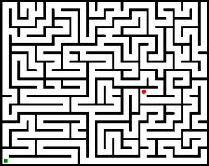
Problem Solving
Well defined problem: All aspects of the problem are clearly laid out. We know the initial state, the rules, and the goal state.
e.g. a maze
ILL defined problem: None of these things are as clear.
“It is the evening before an exam, the text book you need is unavailable in the library and the bookshop is closed”
Starting point? Potential solutions? End point?

Slide 7
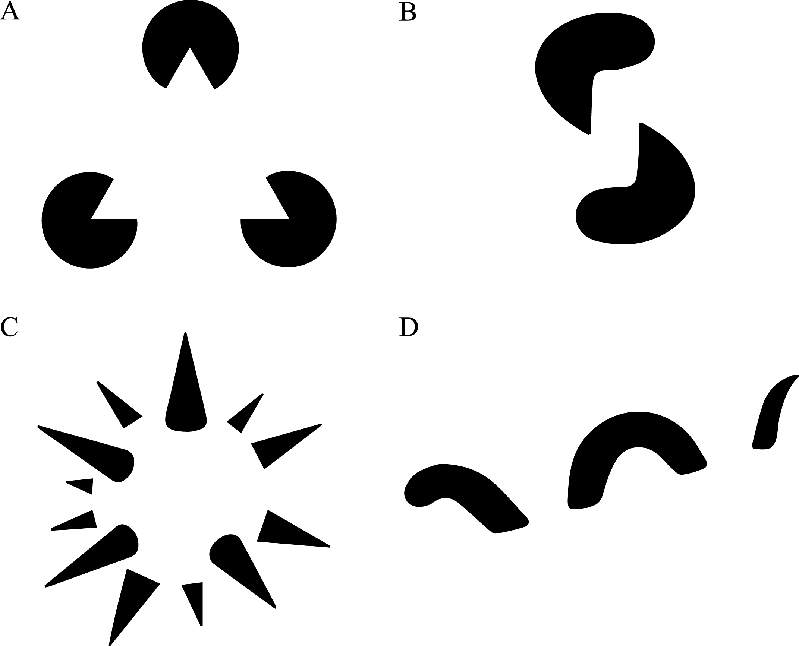
Problem Solving
Gestalt Psychology: A theory of mind that emerged from Germany in the early 20th century
Concerned with entities/experience as a whole rather than consisting of parts

Slide 8
Problem Solving (Gestalt approach)
Proposed by a number of German psychologists in 1920’s and 30’s.
They criticized previous experiments involving arbitrary rules for problem solving (Thorndike’s hungry cats)
They drew a distinction between
reproductive thinking, involving re-use of previous experience, and
productive thinking involving a novel restructuring of the problem

Slide 9
Thorndike first tested his theory on learning behavior using a customized puzzle box in which a hungry cat was placed. The puzzle box consisted of a lever or a loop that could open the door, thereby releasing the hungry cat to freedom and to the food placed just outside the box. He noted the amount of elapsed time it took for the cat to press the lever and free itself. Thorndike discovered that during the first few trials the cat would respond in many ineffective ways, such as scratching at the door, digging at the floor, and pushing at the ceiling, before it discovered the correct solution (pulling the loop or pushing the lever) and was freed from its wooden prison. With each successive trial, it took the cat, on average, less and less time to escape. The cat came to associate the pressing of the lever (or pulling of the loop) with the opening of the door. This has been termed a stimulus – response reaction, with the stimulus "being inside the box" the "pressing of the lever" the response. Trials in puzzle box Initially, the cat’s responses were largely instinctual, but over time, the pressing lever response was strengthened while the others were weakened. Thorndike’s Puzzle-Box The graph demonstrates the general decreasing trend of the cat’s response times with each successive trial. _x000c_The influence of the law of effect The law of effect provided a framework for psychologist B. F. Skinner almost half a century later on the principles of operant conditioning, “a learning process by which the effect, or consequence, of a response influences the future rate of production of that response.”

Slide 10
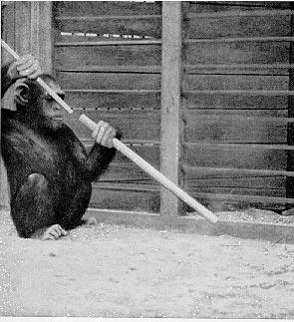
Problem Solving (Gestalt approach)
Insight occurs during productive thinking when the problem is suddenly restructured and the solution becomes clear.
Kohler (1925) observed insight with apes

Slide 11
Problem Solving (Gestalt approach)
Insight occurs during productive thinking when the problem is suddenly restructured and the solution becomes clear.
Kohler (1925) observed insight with apes
Birch (1945) found that apes raised in captivity did not show this level of insight.
Does this mean that our capacity for ‘insight’ emerges from the challenges of survival?

Slide 12
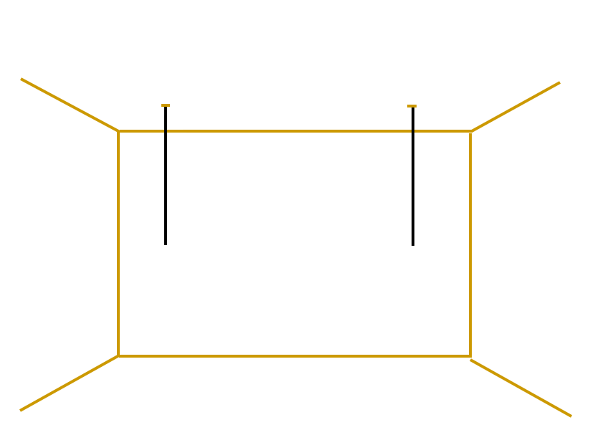


Problem Solving (Gestalt approach)
Maier (1931) asked participants to tie the two strings together
There were a number of objects available in the room (e.g. poles, pliers, extension cords)

Slide 13
Problem Solving (Gestalt approach)
Maier (1931) found it was possible to facilitate insight by ‘accidentally’ brushing against the string.
Those who solved it rarely reported noticing this cue.
Unconscious cues can lead to problem restructuring and then to insight.
Battersby, Teuber & Bender, 1953
Conscious cue speed up solution times

Slide 14
Problem Solving (Gestalt approach)
Evidence that insight is unique: Novick & Sherman found that when rating the experience of solving anagrams both groups often reported ‘pop out’ solutions. ‘The solution came suddenly, seemingly out of nowhere’
Evidence that insight does not work like this: In a different experiment, participants had to indicate after brief exposure if the word was an anagram or not.
Both groups performed better than chance

Slide 15
Problem Solving (Gestalt approach)
Bowden et al., 2005
Remote Associate problems：
Three words (“fence”, “card”, “master”) presented and subjects were required to think of a word that would go with each them to form a compound word (e.g.“post”).

Slide 16
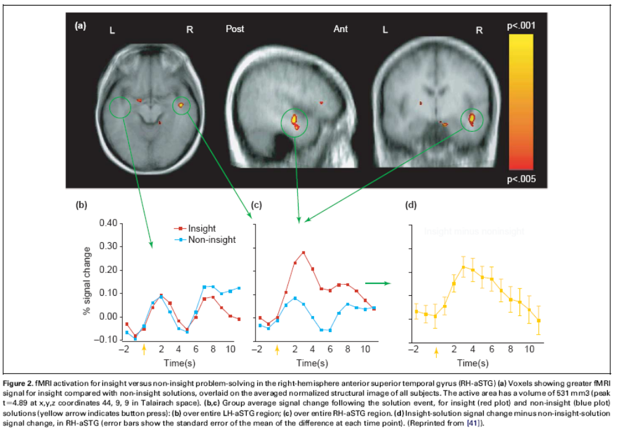
Problem Solving (Gestalt approach)
anterior superior temporal gyrus in the right hemisphere was activated only with insight.

Slide 17
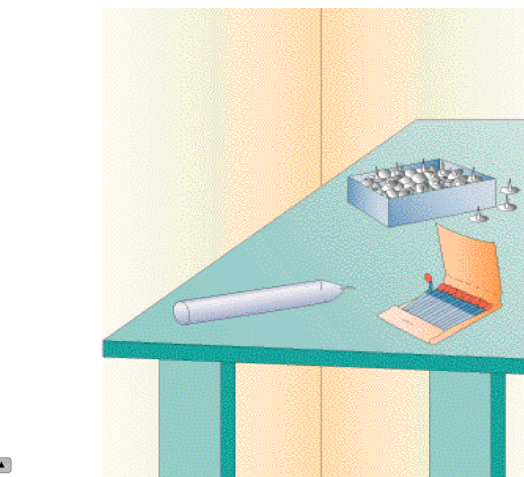
Problem Solving (Gestalt approach)

Slide 18
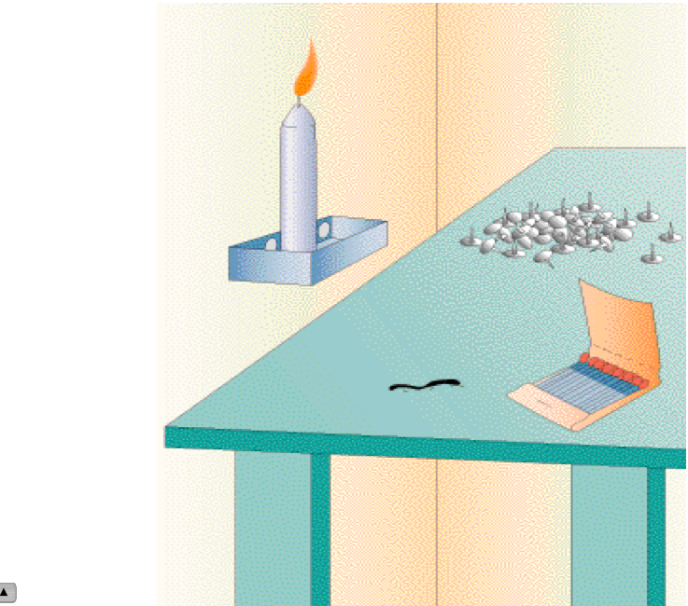
Problem Solving (Gestalt approach)
Functional fixedness

Slide 19
Problem Solving (Gestalt approach)
Functional fixedness is a Gestalt term referring to when learning or past experience impedes problem solving
Duncker (1945) claims that participants fixated on the box’s function as a container
This would seem to be the case as more correct solutions were produced when the box was emptied before presenting the problem

Slide 20
Problem Solving (Gestalt approach)
Evaluation
The notions of problem restructuring, insight and functional fixedness are extremely helpful in discussion.
These same notions can be hard to dissect. Gestalt concepts are often descriptive rather than explanatory

Slide 21
Representational Change
Representational change theory is an attempt to incorporate some Gestalt ideas into a working theory (Ohlsson, 1992)
It is based on the following assumptions:
A problem is represented in a certain way in the person’s mind and this serves as a probe for information from long-term memory
The retrieval process spreads activation over ‘relevant’ long term memory items
A block occurs if the way a problem is represented does not lead to a helpful memory search
The way the problem is represented changes and the memory search is extended, making new information available
Representational change can occur due to ‘elaboration’ (addition of new information) ‘constraint relaxation’ (rules are reinterpreted) or ‘re-encoding’ (functional fixedness is removed)
Insight occurs when a block is broken and retrieved knowledge results in solution

Slide 22
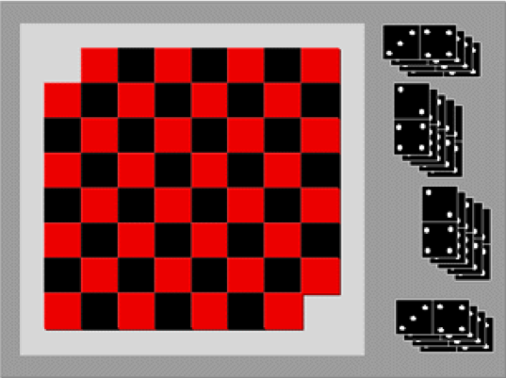
Representational Change
Example: Can the 62 squares on this mutilated draught-board be covered with 31 dominoes?

Slide 23
Representational Change
Mutilated draught-board:
Kaplan & Simon (1990) had participants think aloud as they tried to solve this problem
All started by mentally covering the squares with dominoes (758,148 possibilities!)
Those who solved the problem reported a ‘representational change’ .

Slide 24
Representational Change
Mutilated draught-board:
If each domino is represented as an object covering one black and one red square (re-encoding)
And represent the draught-board as having lost 2 black squares (elaboration)
It becomes clear that no arrangement will allow 31 dominoes to cover the 62 spaces

Slide 25

Representational Change
Draw four straight lines to join all the dots without taking the pen off the page

Slide 26
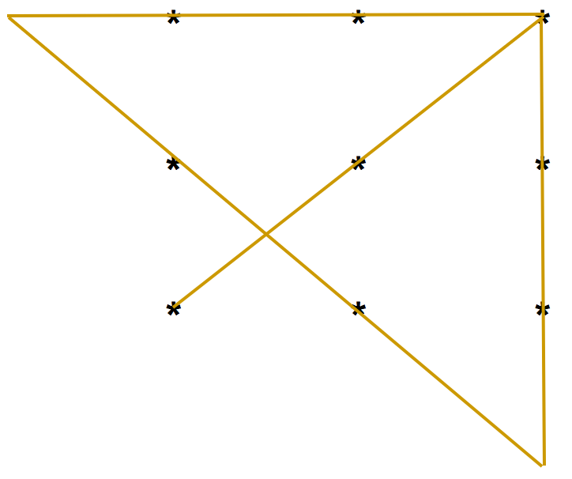
Representational Change
This problem was given to employees at Disney as is reportedly the origin of the expression ‘thinking outside the box’

Slide 27
Representational Change
Participants who did not solve the 9 dot problem usually failed to consider extending the lines beyond the grid
Constraint relaxation mentioned earlier allows someone to consider the correct solution

Slide 28

Representational Change
Knoblich et al. (1999) showed the importance of constraints in reducing the likelihood of insight
Problem: Reposition one match to make this equation correct

Slide 29

Representational Change
Knoblich et al. (1999) showed the importance of constraints in reducing the likelihood of insight
Problem: Reposition one match to make this equation correct

Slide 30
Representational Change
Our experience of equations often involves changing numerical values as in
But not changing operators (+, -, =)
Eye movements recording

Slide 31
Representational Change
Insight is more difficult in the second example because re-encoding operators is more advanced than re-encoding numerical values.
Knoblich et al also included eye tracking data which showed a great deal of attention was paid to the numerical symbols but not the operators.
‘Thinking outside the box’ allows us to see the operators as changeable also
'insight' problem-solving task performance: lateral frontal patients 82% vs. normal 43% (Reverberi et al., 2005)

Slide 32
Progress Monitoring Theory
MacGregor et al (2001) have put forward this theory. There are two main features
Maximisation heuristic: Each move or decision is an attempt to make as much headway as possible towards the goal
Progress monitoring: The rate of progress is assessed constantly, and if it is deemed to be slow and inefficient criterion failure occurs. An alternative strategy is then sought.

Slide 33
Progress Monitoring Theory
MacGregor et al. version of nine dot problem
A
B

Slide 34
Progress Monitoring Theory
If ‘constraint relaxation’ is all that is required to think outside the box, then participants should do better on A than B
If criterion failure is necessary then participants will do better on B, because they can cover fewer dots in the next two moves, and so will realize they are on the wrong path sooner.
MacGregor et al. found that only 31% of those given A were successful. Compared to 53% of those given B.

Slide 35
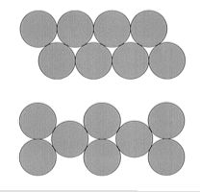
Progress Monitoring Theory
Ormerod et al. (2002) 8 coin problem.
Moving only 2 coins, leave each coin touching 3 others

Slide 36
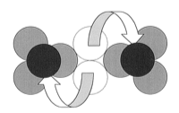
Progress Monitoring Theory
Ormerod et al. (2002) 8 coin problem.
Moving only 2 coins, leave each coin touching 3 others

Slide 37
Progress Monitoring Theory
Ormerod et al. (2002) 8 coin problem.
Moving only 2 coins, leave each coin touching 3 others

Slide 38
Progress Monitoring Theory
Ormerod et al. (2002) 8 coin problem.
If the strategy employed simply seeks to achieve a short term goal of bringing one particular coin to rest in contact with 3 others, then there is ‘no move available’ in the first condition, but 20 moves available in the second
92% solved the problem in the first condition, 67% in the second
Again, strong evidence for the importance of ‘criterion failure’

Slide 39
Progress Monitoring Theory
Evaluation:
The central claim being that insight is most likely to occur when constraint relaxation is combined with criterion failure.
Deals well with the motivation for changing strategy

Slide 40
Transfer of Training
Refers to how our experience of past problems influences our ability to solve new ones.
Not surprisingly there can be positive and negative transfer
Positive transfer: Previous experience allow to solve the current problem faster and more easily
Negative transfer: Solving a problem in the past disrupts to solve a similar current problem

Slide 41
Transfer of Training
E.g of negative transfer: Luchins (1942) water jar problems
Jars: 28L 76L 3L
Aim: 25L
Participants who had trained on a number of difficult 3 jar solutions requiring the same complicated process failed to see the simplicity of the solution here

Slide 42
Transfer of Training
Other factors to be considered
Far transfer: Refers to transfer to a dissimilar context
E.g. Learning about experimental method in science class (control groups, confounding variables etc.) and using the same principles in real world settings (deciding how to make the nicest biscuits)
Near transfer: Transfer to a similar context
E.g. Learning Luchins’ water jar solutions
Lab studies often limited to near transfer

Slide 43
Transfer of Training
Transfer distance (Chen & Klahr, 2008)
Task similarity: Similarities between the problems in superficial (objects amd their properties) and structural () features.
Context similarity: Similarities in physical context (location) and social context (people)
Time interval: the period of time between the past and present problems

Slide 44
Lecture overview
Types of problems
Theories
  Representational Change Theory
  Progress Monitoring Theory
Transfer of Training

